Slide 1
1.2 Commissioners (1 of 2)
Note: full version available as PDF
The 25 commissioners were carefully selected to bring diverse points of view to creating a report that speaks to the many different types of people who make or can influence decisions about whether and how evidence is used to address societal challenges. This diversity is reflected in many ways:
All six world regions and 10
of the 12 most populous
countries**
Speaking the
six most widely spoken
languages***
Powerfully complementary perspectives*
Spectrum of experience and seniority
Mix of
ethno-racial
backgrounds
Gender
balance
*
**
***
Ranging across most types of societal challenges (and Sustainable Development Goals), all types of decision-makers (government policymakers, organizational leaders, professionals and citizens), and all major forms of evidence
China, India, United States, Indonesia, Pakistan, Brazil, Nigeria, Mexico, Japan and Ethiopia, as well as Australia, Austria, Canada, Chile, Germany, Trinidad and Tobago, United Arab Emirates, and United Kingdom
English, Chinese, Hindi, Spanish, French and Arabic, as well as Portuguese, Indonesian and Urdu, among others
1
Notes:
RECORD

Slide 2
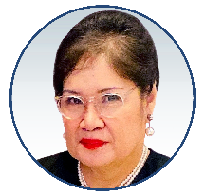
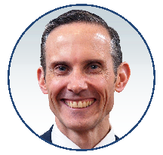
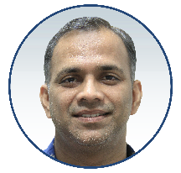
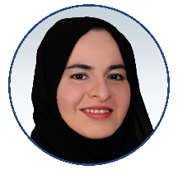
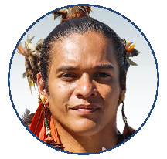
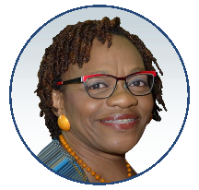
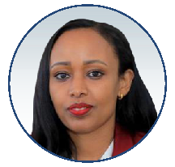
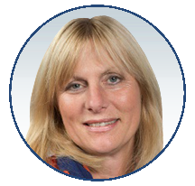
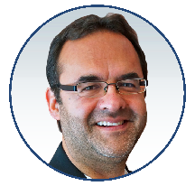
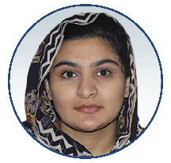
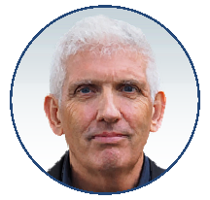
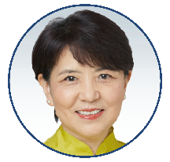
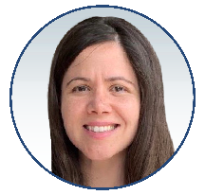
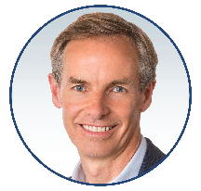
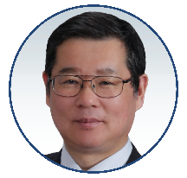
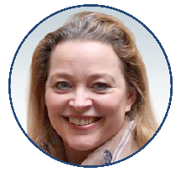
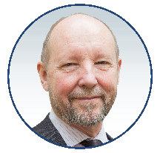
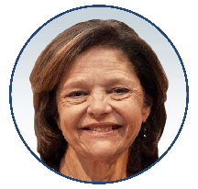
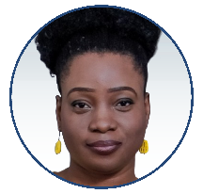
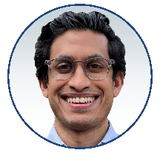
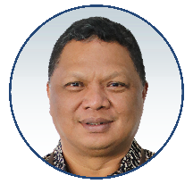
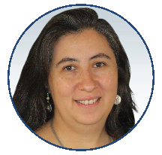
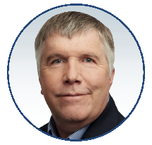
1.2 Commissioners (2 of 2)
Amanda Katili Niode
Talented policy advisor and non-governmental organization director advancing dialogue about environmental action, including climate action
Andrew Leigh
Seasoned politician bringing economics and legal training to public-policy writing and debate
Antaryami Dash
Non-governmental organization leader bringing nutrition expertise to the development and humanitarian sector
Asma Al Mannaei
Experienced public servant leading quality improvement and stewarding research and innovation across a health system
Daniel Iberê Alves da Silva
Young Indigenous leader educating students and others about Indigenous ways of knowing
David Halpern
Trusted policy advisor bringing formal experimentation and behavioural insights into governments, first in the United Kingdom and now in many countries
Donna-Mae Knights
Career public servant, specialized in poverty reduction and development, driving policy change towards building sustainable communities
Fitsum Assefa Adela
Committed policymaker striving to bring a whole-of-government perspective to cabinet-level planning and development
Gillian Leng
Experienced executive leading a technology-assessment and guideline agency that supports health and social care decision-making by governments, service providers and patients
Gonzalo Hernández Licona
Distinguished economist bringing rigorous evaluation methods to the fields of poverty measurement and economic development
Hadiqa Bashir
Young leader advocating for girls’ rights and gender equality in male-dominated environments
Howard White
Research leader supporting the use of robust evaluation and evidence synthesis in decision-making in international development and across sectors
Jan Minx
Impact-oriented scholar bringing innovative evidence-synthesis approaches to domestic policy advice and global scientific assessments about climate change and sustainability
Jinglin He
Non-governmental organization leader engaging policymakers and stakeholders, as well as UN agencies, in advancing social-development initiatives
Julia Belluz
Respected journalist bringing rigour to reporting about what the best available science does and doesn’t tell us about the major challenges of our time
Julian Elliott
Clinician researcher leveraging technology for efficiently preparing and maintaining ‘living’ evidence syntheses and guidelines to inform decision-making
Kenichi Tsukahara
Engineering leader supporting disaster risk management in government, a development bank, and international agency
Kerry Albright
Eternally curious international public servant bringing passion about evidence-informed decision-making, systems thinking, and helping others understand the value of evidence to international development
Maureen Smith
Citizen leader championing the meaningful engagement of patients and citizens in conducting research and using it in their decision-making
Larry Hedges
Applied statistician driving the use of evidence synthesis in educational policy and practice
Modupe Adefeso-Olateju
Non-governmental organization leader pioneering the use of citizen-led assessments and public-private partnerships to improve educational outcomes for children
Neil Vora
Interdisciplinary professional bringing planetary-health thinking to the interface between conservation efforts (such as preventing deforestation) and pandemic prevention
Petrarca Karetji
Entrepreneurial policy advisor innovating in the use of data analytics to support evidence-informed policymaking about sustainable development
Soledad Quiroz Valenzuela
Government science advisor contributing her national experiences to regional and global efforts to improve the quality of government scientific advice
Steve Kern
Foundation leader using data analytics and other forms of evidence to fight poverty, disease and inequity around the world
2

