Slide 1


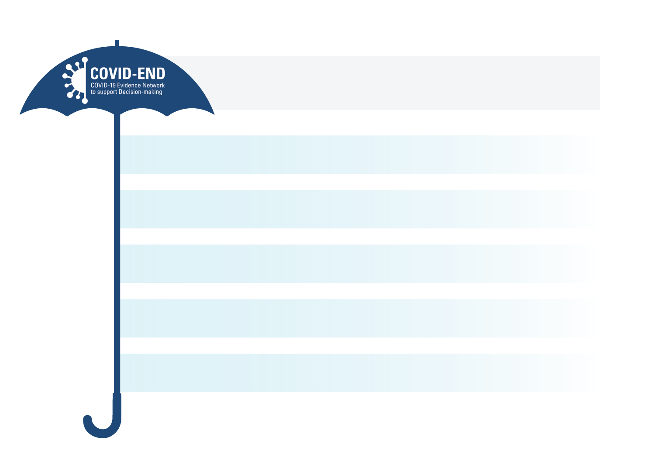
1.5 Connection to COVID-END (1 of 2)
Note: full version available as PDF
COVID-END acts as ‘umbrella’ for these partners in the time-limited evidence response to COVID-19, and many of them in turn act as an umbrella for many other partners in addressing a broad range of societal challenges. Examples of these umbrella organizations include:
Building from the COVID-19 Evidence Network to support Decision-making (COVID-END), a partnership of 55 partners, world-leading evidence synthesis, technology assessment and guideline groups.
Africa Centre for Evidence, which supports the Africa Evidence Network in bringing together more than 3,000 people from across Africa to support evidence-informed decision-making
Campbell Collaboration, which supports teams around the world to prepare and support the use of evidence syntheses in areas like business and management, climate solutions, crime and justice, disability, education, international development, and social welfare
Cochrane, which includes review groups around the world that prepare evidence syntheses, and geographic groups in 45 countries and thematic networks in 13 domains that support evidence-informed decision-making on health-related topics
Evidence Synthesis International, which supports evidence-synthesis organizations around the world that produce, support, and use evidence syntheses
Guidelines International Network, which supports 130 organizations around the world that develop and implement evidence-based guidelines.
1

Slide 2


1.5 Connection to COVID-END (1 of 2)
2

