Slide 1
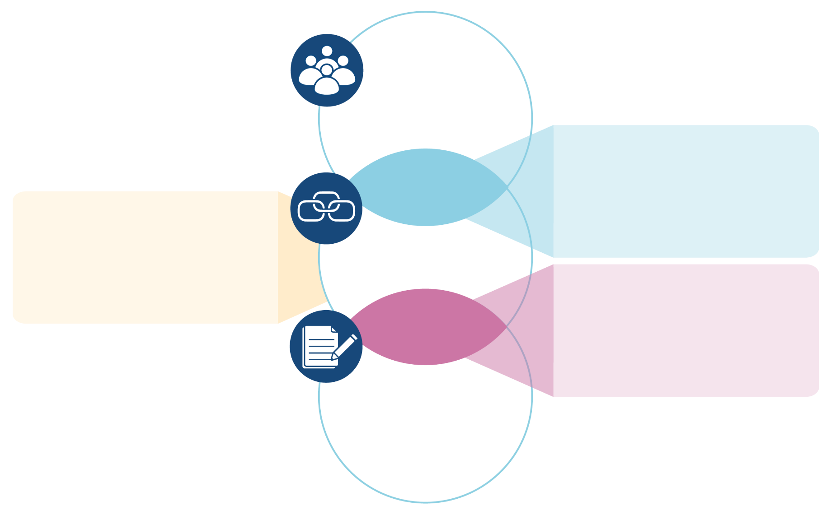
5.1 Types of evidence intermediaries
Decision-makers
Technical units within multilateral organizations that support member. states
Domestic and global commissions
Government advisory bodies
Government science advice
Government evidence support
Hybrid
decision-makers/
intermediaries
Fact-checking organizations
Science academies
Think tanks
Knowledge-translation platforms (and knowledge brokers)
Intermediaries
Impact-oriented units that provide:
Data analytics
Modeling
Evaluation
Behavioural /
implementation
research
Hybrid
Intermediaries/
producers
Qualitative insights
Evidence synthesis
Technology assessment
Guidelines
Producers
1

