Slide 1
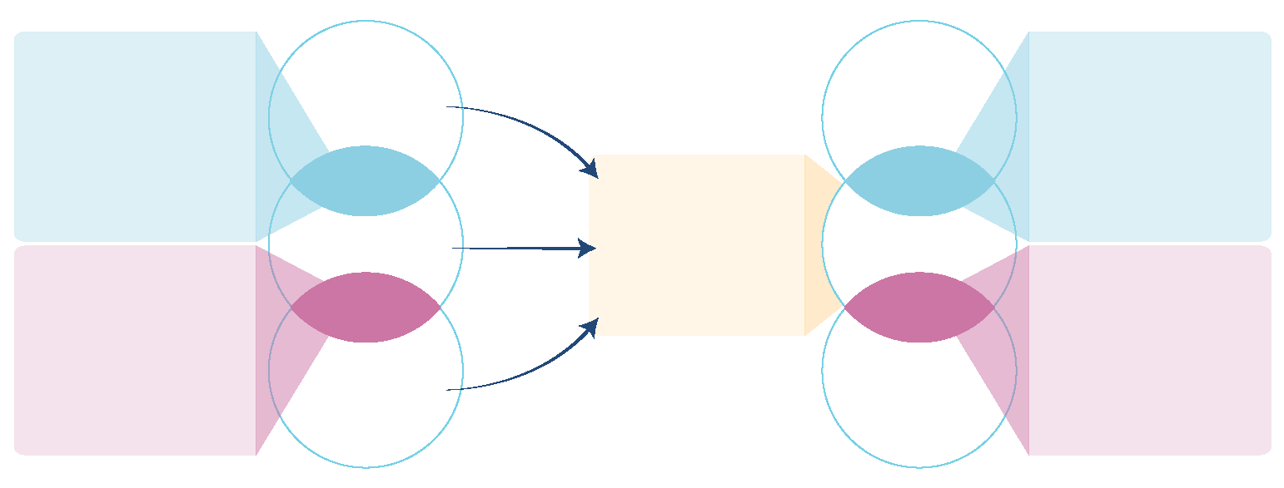
6.2 Equitably distributed capacities needed to support evidence use
Global level
Local (national or sub-national) level
Global hybrid decision-makers and intermediaries
(e.g., global commissions and technical units within the global, regional and country offices of multilateral organizations that support member states)
Normative
guidance
Local hybrid
decision-makers and intermediaries
(e.g., domestic commissions, government advisory bodies, government science advice, and government evidence support)
Decision-makers
Decision-makers
Hybrid
Local evidence
intermediaries
(e.g., fact-checking organizations, science academies, think tanks, and knowledge-translation platforms)
Hybrid
Technical
assistance
Intermediaries
Intermediaries
Global hybrid
evidence intermediaries and producers
(e.g., Cochrane and Intergovernmental Panel on Climate Change (IPCC) working groups)
Hybrid
Hybrid
Local hybrid
evidence intermediaries
and producers
(e.g., local impact-
oriented units)
Producers
Producers
Evidence-
related global
public goods
1

