Slide 1
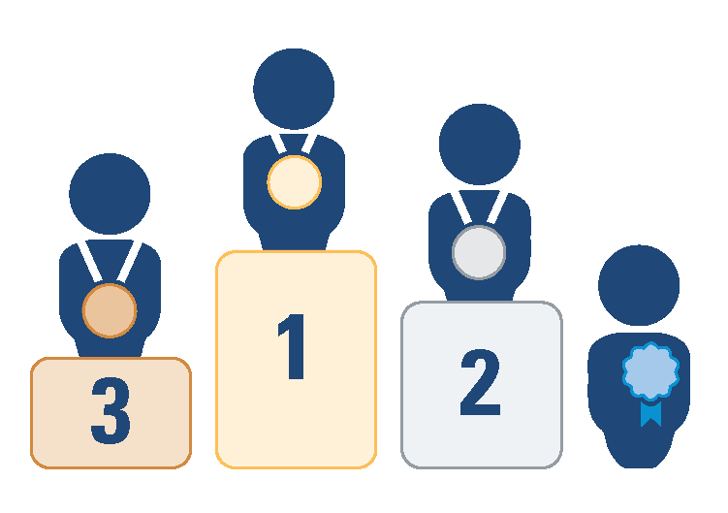
0.4 Use best evidence (vs other things that get a lot of attention now),
and the specific example of expert panels
Note: full version available in Update 2023
If Australia can go for the gold with its national health guidelines, why can’t we do it in our country and for other sectors?
Single studies (or preprints) that haven’t been appraised for quality and placed alongside all other studies addressing the same question
Gold
Expert panels that:
convene people with the right mix of issue-specific knowledge, evidence-appraisal expertise, and lived experience
follow rigorous processes to develop their recommendations (e.g., pre-circulate evidence summaries and clarify what evidence and experiences underpin the recommendations)
adjust their recommendations as the context, issues and evidence evolve (in the case of living expert panels)
Squeaky-wheel experts who don’t speak in a way that make it possible to judge their accuracy
Old-school expert panels using a GOBSATT approach
Best evidence for the type of question being asked
Citizen- and stakeholder-engagement processes that don’t provide ‘ways in’ for evidence
Will never make it to the podium
Expert panels using a GOBSATT (good old boys sitting around the table) approach
© 2023 McMaster University. All rights reserved. This work is licensed under a Creative Commons Attribution-NonCommercial-ShareAlike 4.0 International License.

