Slide 1
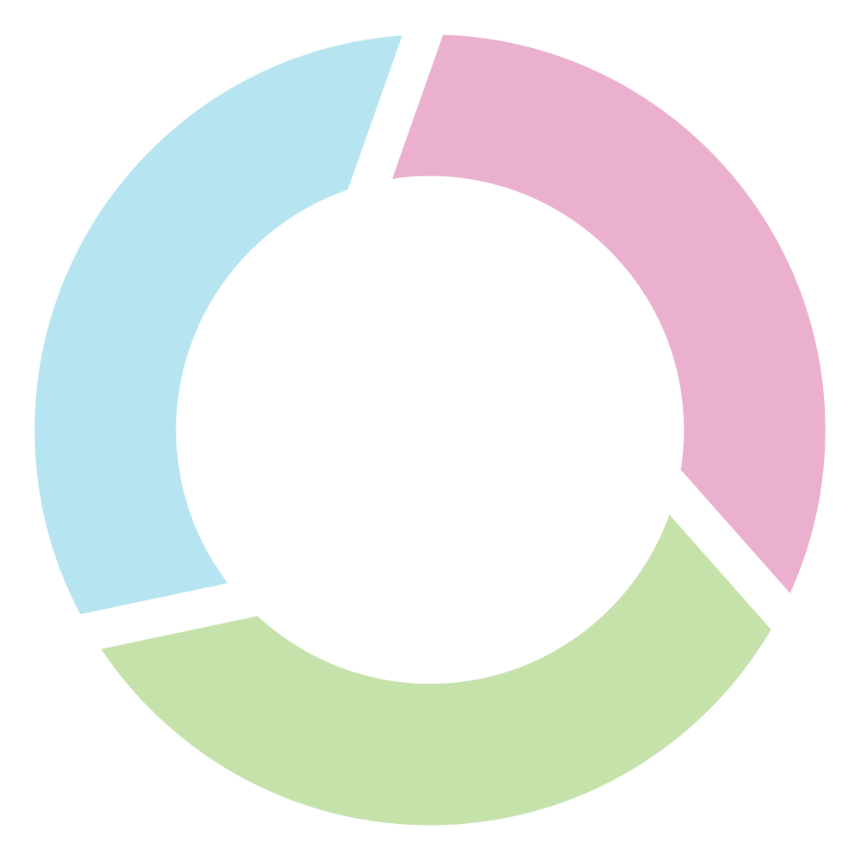
2.1 One possible model for improving coordination: Start by better connecting global and domestic
Note: full version available in Update 2023
Global public-goods producing teams
Each commits to respond to emerging global priorities in ways that increase coordination and reduce duplication in the production of living evidence syntheses
They collectively commit to work with existing networks and platforms to maximize efficiencies and synergies and to strengthen and implement standards (for a fuller list, see the footnote on the preceding page)
Networks of producers of global public goods (e.g., Campbell, Cochrane, IPCC)
Platforms that support the production of global public goods (e.g., PROSPERO)
Networks of guideline and technology-assessment groups that use these global public goods
Domestic evidence-support networks that use these global public goods and that can bring forward the perspectives of many types of decision-makers who use these global public goods (government policymakers, organizational leaders, professionals, and citizens)
Global public-goods
Domestic evidence-
producing teams
support networks
Better connect global and domestic
BEST
EVIDENCE
Domestic evidence-support networks
Each commits to respond to emerging domestic priorities in ways that leverage and enable the implementation of global public goods (e.g., through contextualized evidence synthesis and support) and to support the continuous improvement of global public goods (through partnerships with teams in their region or with similar topic coverage)
They collectively commit to work with existing networks and platforms to maximize efficiencies and synergies and to strengthen and implement standards
Networks of evidence-support units (e.g., Brazil Coalition for Evidence, What Works Network in the U.K., EVIPNet in low- and middle-income countries)
The Living Evidence Alliance is a promising prototype, but we have a long way to go with hundreds of low-quality evidence syntheses for unimportant questions and none for many of society’s most important questions
IMPACTS
We were able to respond to a question from national policymakers with a contextualized evidence synthesis on climate-adaptation strategies in three days because a living evidence synthesis was ‘sitting there’ with more than 17,000 studies already identified and assessed
Paradoxically, some global public-goods producers like Cochrane are in their most fragile funding position ever, and others like Campbell have never been sustainably funded
© 2023 McMaster University. All rights reserved. This work is licensed under a Creative Commons Attribution-NonCommercial-ShareAlike 4.0 International License.

